Slide 1
Current: $187.71 Target: $231.96 (+24%) Time Horizon: 12-18 Months
L3HARRIS Technologies Inc. (NYSE: LHX)
Industry Director: Michael Betancur
Analysts: Bricen Fisher, Nirmal Malhotra, Ray Hatton
Junior Analyst: Baani Dhiman

Slide 2
Company Overview
Business Description
Customer Breakdown
L3HARRIS is an aerospace and defense company headquartered out of Melbourne, Fl
L3HARRIS provides military and commercial grade equipment internationally
Specializes in Integrated Mission Systems, Space & Airborne Systems, Aviation Systems, and Communication Systems
Serving customers in +100 countries internationally with +48,000 employees in 45 countries worldwide
Business Highlights
Revenue Breakdown
L3 Technology and Harris Corporation had a merger in July 2019 creating L3HARRIS
$185M in cost synergies in 2020 with expectations of $300M of cost synergies in 2021
L3HARRIS historically has been generous to its shareholders
Shareholder buybacks up to ~$2.2B in 2020 from ~$1.7B in 2019 ; Annual dividend of $3.40 per share
L3HARRIS consistently innovates
Total revenue ~18B in 2019
~3.8% of revenue spent on R&D or around $684m
Sources: Investor Presentation, Company Filings

Slide 3


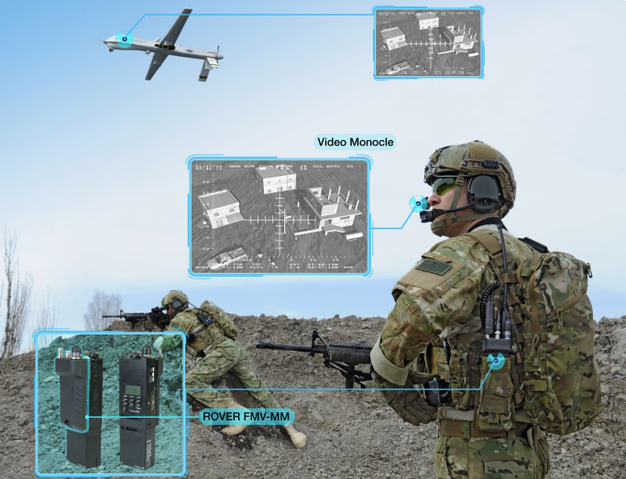

Segment Overview
Integrated Mission
Space & Airborne
Communication Systems
Aviation
Leader in market
Provides ELINT and COMINT targeting systems
Provides Electronic integration systems for naval platforms
Provides Electronic and Optical sensor systems
Contracts with USA, Australia, Canada, United Kingdom, Singapore, Taiwan and many other countries
Revenue up organically by 6.2% YOY in 3Q20
Operating income increased 21% YOY in 3Q20
LHX provides solutions for space, avionics, electronic warfare, and intel & cyber
Contracts with
USA, Australia, Egypt Iraq, and United Kingdom
Commercial contracts with Boeing, Lockheed Martin, and Northrop Grumman
Provides parts for prominent fighters including but not limited to F-35, F-16, F-22, B-2 KF-X, F/A-18, and P-8
Revenue up organically by 6.8% YOY in 3Q20
LHX provides solutions for
Tactical Comms
Public Safety
Broadband Communications
Integrated Vision
Consistentt innovation in SWaP (Size, Weight, and Power)
Expected growth from replacing legacy communication systems
Strong lifecycle support
Revenue up organically by 6.7% YOY in 3Q20
Operating income increased 17% YOY in 3Q20
LHX provides solutions for
Defense Aviation
Mission Networks
Commercial and Military Training
Commercial Aviation
Contracts with USA and Commercial Contracts with Delta, Qantas, British Airways, and Airbus
FAA ADS-B Systems
Planned expansion in India and Australia
Revenue down organically by 4.1% YOY in 3Q20
Operating income down 19% YOY in 3Q20
Sources: Investor Presentation, Company Filings
Notes:
ELINT detects radio frequency emissions from submarines, surface ships, aircraft and land-based radars.
COMINT: Communications Intelligence
Apart of electronic warfare, Game of cat and mouse.
US navy awarded $383m contract in march 2020. The company will provide receiver-transmitters and transit case and vehicle-based HF systems that are based on the RF-300H manpack radio technology.
Sat and ground systems which is fully integrated.
FAA ADS-B systems
L3Harris owned and operated network Largest air traffic control surveillance network in world; broadcasts aircraft position to ground 650+ radio stations across US; covering 4 million sq mi of U.S. airspace with 1,100 surveillance sensors FAA equipage mandate requiring ADS-B in all controlled airspace effective January 2020.

Slide 4
Financial Overview
52 Week Price Change
Enterprise Value Walkthrough
$ in Millions
Share Price | $181.04
Shares Outstanding | 210.1
Equity Value | 38,038.7
Cash & Short-Term Investments | 1,341.0
Total Debt | 7,666.0
Preferred Equity | NA
Minority Interest | 126.0
Enterprise Value | 44,489.7
$187.71
Financial Highlights
Key Metrics
1. LHX sells EOTech business to American Holoptics
This business produces holographic sighting systems, magnified optics, and accessories for commercial markets. Financials not enclosed
2. Aviation suppliers expected to lose $60B
Rise of COVID-19 caused a decrease in travel, reducing need for new or replacement equipment
3. LHX beat 3Q20 EPS estimates by 4.4%
Revenue was down slightly 0.8% by estimates but 0.7% up YOY
Market Cap | $38.04 Bn
52 Week Range | $142.01 - $230.99
EV/EBITDA | 10.3x
LTM Gross Profit Margin | 28.2%
LTM P/E | 15.99x
Beta | 0.75
4

Slide 5
Industry Overview
Aircraft Defense
Avionics Market Size ($B)
Aircraft Defense market size is poised to grow at a 3.25% CAGR through 2025 reaching $42.87B globally
Innovation around pre-existing & new market fighters internationally such as the F-35 is driving demand in aircraft defense
Lockheed Martin requires parts from L3HARRIS including but not limited to cockpit displays, smart weapons rack, infrastructure components, and other classified parts
Maritime Defense
UUV Market Size ($M)
Maritime Defense market size is expected to grow at a 8.51% CAGR through 2025 reaching $29.91B internationally
Unmanned vehicles are rapidly increasing in demand with the US Navy forecasting ~1.2B in spending in 2021
L3HARRIS’s has been awarded a $281 million US Navy contract to develop unmanned vehicles
Huntington Ingalls is interested in this market but is not directly working with the government to produce unmanned vehicle
5
Notes:
Huntington Ingalls is working with Boeing to fulfill a contract for UV but not

Slide 6
Investment Rationale
Creates sure free cash flow & steady growth even in flat spending environment
Its product portfolio is geared around strategic priorities, like space and electronic warfare with +48% spending increase to $4.4 billion in 2023
LHX has stable, predictable revenues due to their record Backlog and stable spending seen in 2020
Space defense budget request are +15% to $14.1 billion, & the cyber request is +10% to $9.6 billion for 2021’s defense spending budget
Biden isn’t planning major defense cuts & Trumps budget proposal was $740 billion, +$19 billion YoY
Defense Spending in the US ($B)
CAGR 2.6%
Expanding margins while consistently growing revenue and backlog
Revenue grew organically across the board at ~6% save aviation due to weak growth in the industry
Integrated Mission Systems increased operating margin +3% from 12.6% to 15.7%, creating an operating income boost of roughly 30%
L3 and Harris merger has allowed has realized $500 million in cost synergies one year ahead of schedule continuing aggressive cost optimization
Backlog grew 3% to $20.6 billion providing support in uncertain times of spending. LHX’s book-to-bill ratio of 1.1x shows LHX booking more orders than delivered
LHX Backlog ($B)
Sources: Company Website, Company Presentation, militaryaerospace.com, marketsandmarkets.com, Credit Suisse

Slide 7
Investment Rationale
Substantial growth in Integrated Mission Systems under electro-optical & maritime markets
ENVG-B goggles detect 80% of targets at 150m, +50% higher than the current use 3rd Generation NVG at only 30% of targets being detected at 150m
In late October, LHX awarded $442 million at ~88,000 units with 77,000 expected for all 3rd-Gen replacement
Autonomous Underwater Vehicle market to grow from $638 million to $1.6 billion in 2025 at a CAGR of 20.8% used for anti-submarine warfare & pipeline monitoring
DOD requests a 10x budget increase on unmanned vessels & +50% more for robotics development totaling $3.7 billion on unmanned systems & $900 million on AI
AUV Market ($M)
Fastly growing space-based warfare threat creates revenues for LHX’s Space segment
Space Force tracks +26,000 satellites & growing rapidly. Sorting threats in more crowded space environment is becoming increasingly difficult
As Space Force matures, spending will grow $2.6 billion over the next five yrs. Procurement spending will nearly double from $2.4 to $4.7 billion in 2025
Developing end-to-end satellite defense system under $193 million fixed-price contract, likely to increase along with Space Force spending and need for defense
LHX Achieved 25% life-cycle cost reduction & improved performance for Air Force Space Command support
Satellites in Orbit
Sources: Company Website, Company Presentation, militaryaerospace.com, marketsandmarkets.com

Slide 8
Investment Rationale
Geopolitical and security challenges drive growth across the board
LHX entered a strategic partnership with Inmarsat to deliver Global Xpress L-TAC satellite communications services to government customers worldwide
Awarded $380 million indefinite delivery indefinite quantity contract for WESCAM MX-Series products & services for U.S. surveillance & targeting ops
LHX is the #1 provider of simulators for USAF with 90% of F-16 simulators in use on +8 training systems
Over 1,500 aged F-16s & A-10s are being replaced by F-35s with major infrastructure & training from LHX. LHX will continue to capture growth from this transition
Number of F-35s Active
Leader in winning Government contracts thanks to superior technology
Secured a 10-yr award as prime mission integrator on major projects generating +$2 billion in sales
LHX recently secured a five-year $97.5M contract from USAF to manage electronic warfare module repairs to eight foreign military customers
LHX creates sticky revenue where contractual products require continuous maintenance and training. LHX has also seen massive contract procurement in Q3
L3HARRIS recently secured a $1.3 billion contract driving revenue over 10 yrs with +10 global agencies
Defense Budget for Democratic Presidents (+%)
Sources: Company Website, Company Presentation, militaryaerospace.com, defense.gov, macrotrends.net
Notes:
Johnson – Vietnam, Carter –Cold War

Slide 9
Portfolio Placement
Annual Net Income Margin
5 Year Index
136%
72%
21%
Portfolio Allocation
Capturing Trends in Growth Markets
Reallocation of portfolio to capture future trends creating an upside potential of over 24%
LHX serves to capture growth in future trends in markets that remain untapped by large industry players such as LMT and HII
LMT and HII have seen poor performance that has not created alpha in large for the IMG portfolio. LHX will allow IMG to capture the growth from an LMT competitors that is consistently winning over LMT
LHX becoming the 6th largest in the defense market allows continued growth government relations
LHX has a history of winning contracts in growing industries like space and maritime at a record of over 55% for 2020
LMT and HII remain focused on their main offerings without creating much effort to go outside their focuses (aircraft & ship building) to venture into new growth markets
Sources: CAPIQ, Company Website, Transition Report
Notes:
LMX and HII continue to milk cash cows on large government contracts with little focus on future trends

Slide 10
Competitive Landscape
Mkt Cap | 101,684.6
Net Income | 6,539
Beta | 0.94
Mkt Cap | 6,353.2
Net Income | 528
Beta | 0.95
Mkt Cap | 87,907.7
Net Income | (2,511)
Beta | 0.79
Operates in the aerospace, defense, arms, security and advanced technology sector globally
LMT strongly relies on LHX to improve their avionics system as well being dependent on LHX for their displays in the F-35 Aircrafts
Turkey was dropped from the F-35 program. LMT will have to find a new supplier to replace the over 900 parts Turkey makes
Pentagon cancelled LMT’s $928M contract to develop HSCW due to funding priorities
Instead chose $382M Air Force contract to develop ARRW
Manufacture and design military grade ships under the three segments: Ingalls Shipbuilding, Newport News Shipbuilding and Technical Solutions
HII current gross profit margin is 17.25% vs LHX Gross Profit Margin of 28.2%
High employee attrition rate
Despite spending over $100 million a year in development and training for their employees which is significantly higher than its competitors, employee turnover rate is very high
Operates in the aerospace and defense manufacturing sector
RTX is the result of the merger between United Technologies Corporation and Raytheon Company in April 2020
RTX was kicked off the Dow Jones index on Aug 31 because of its low share price ($64.99) and replaced by Honeywell ($196.99)
Their EPS fell 2% on average annually with sales rising only 1% for the past three years
RTX has an 8.35% ROE VS a 28% ROE for LHX
Sources: CAPIQ, Motley Fool, Earnings Call Transcript, Investor’s Business Daily, Zacks

Slide 11
Valuation
LHX Stock Price Growth Potential
$257.01 (+37%)
$209.92 (+12%)

Slide 12
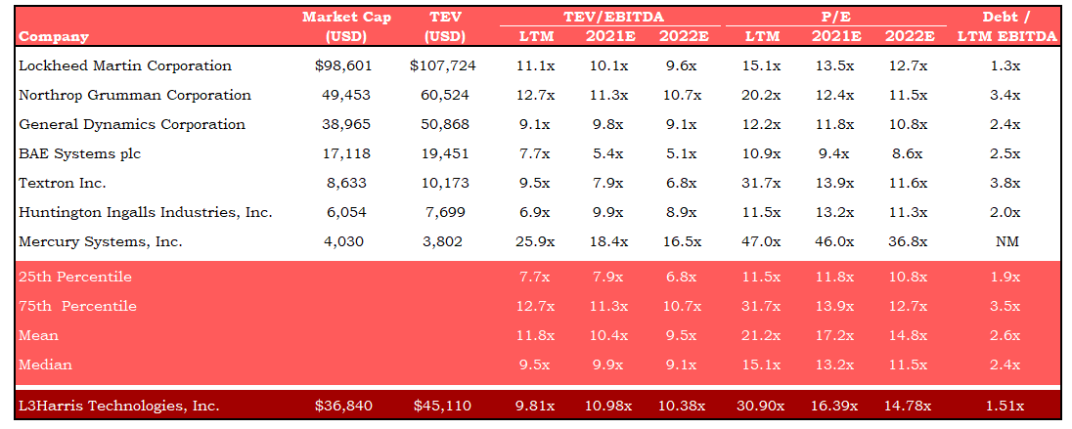
Public Comparables

Slide 13
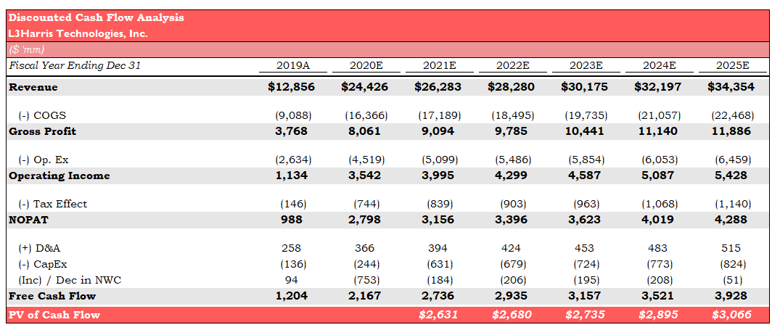
DCF

Slide 14
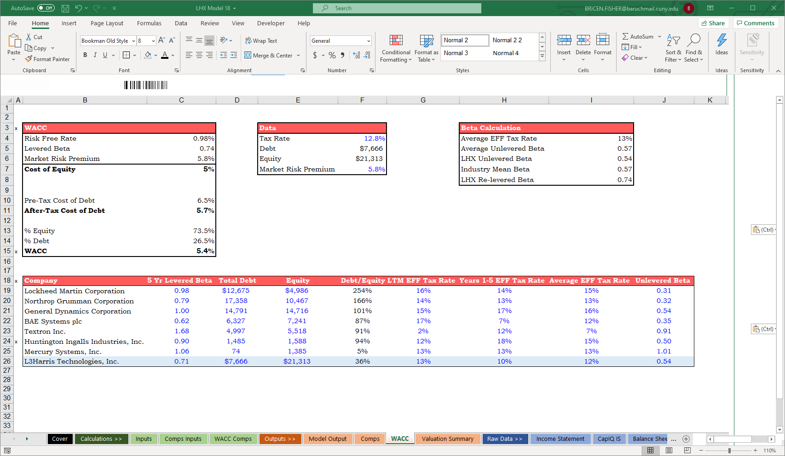
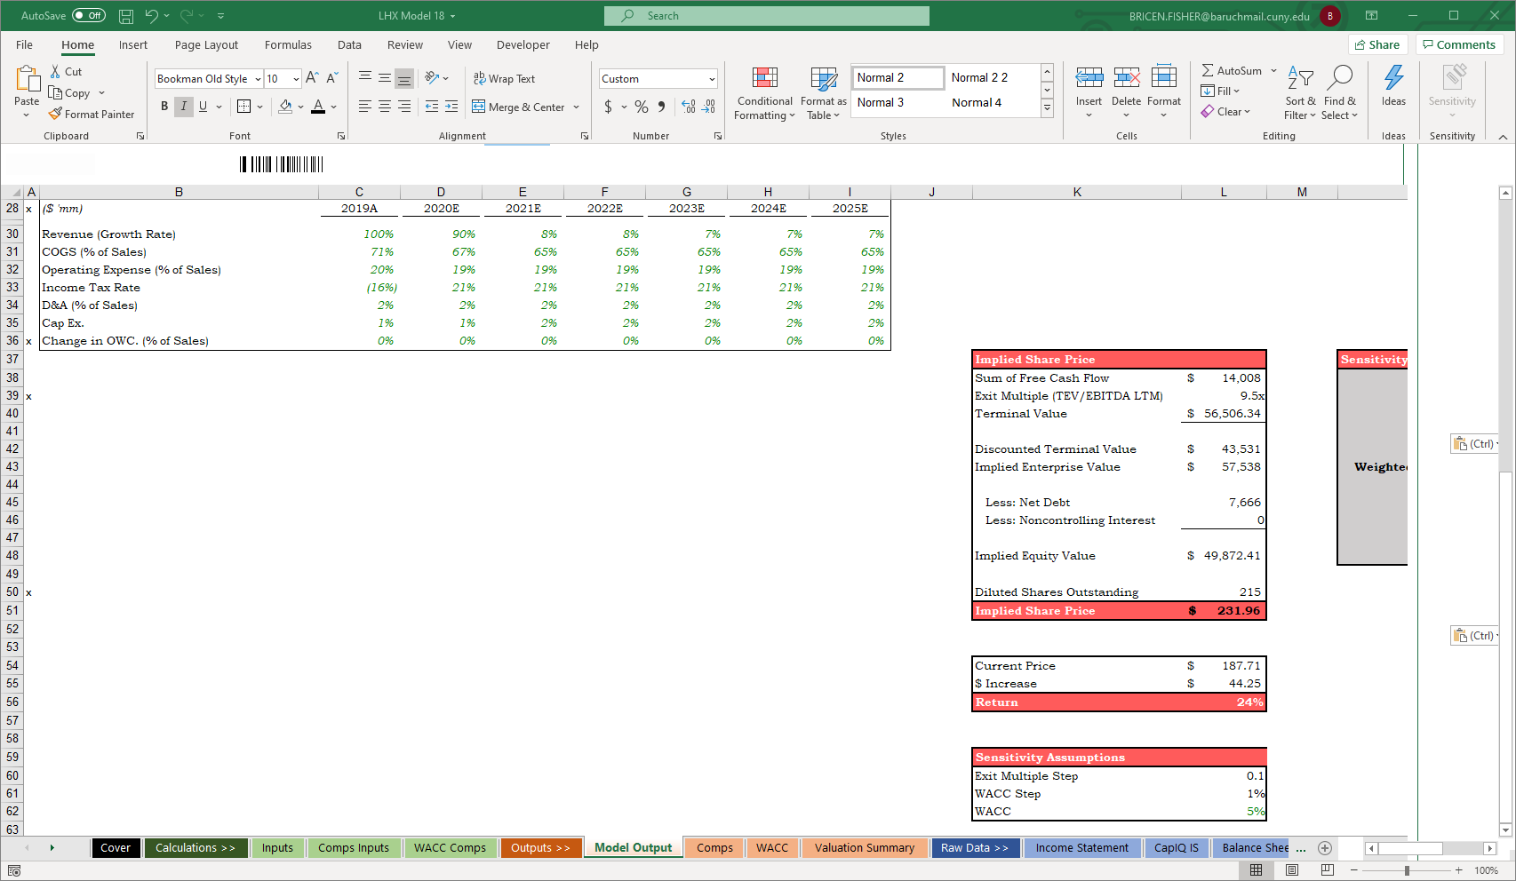
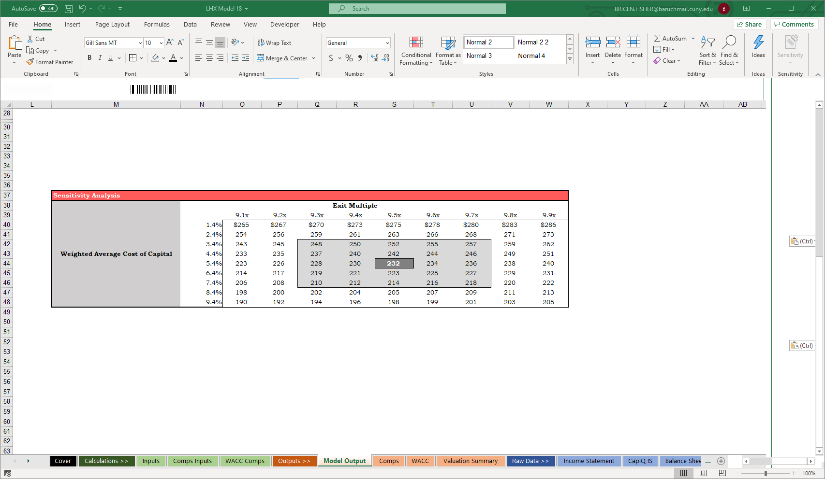
DCF Output

Slide 15
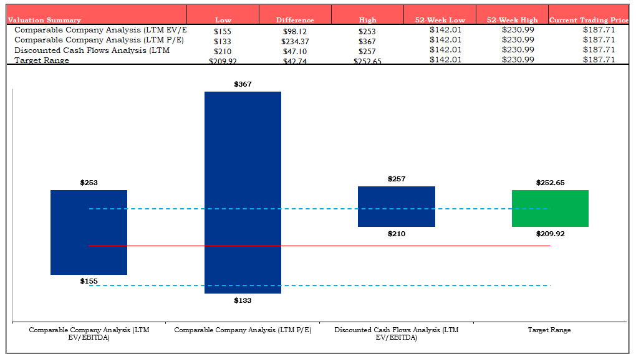
Football Field Analysis

Slide 16
Potential Risks
Due to the pandemic & severe decline in global air traffic, the commercial aviation market downturned and demand for flight training, simulators, etc. significantly reduced
Mitigant: CEO Brown says supply-chain disruptions have been minimal. L3HARRIS also identified business units with 8-10% of revenues that “don’t strategically fit with the company” planning their divestures. In May, L3HARRIS sold its airport security & automation business for $1B increasing cash on hand to cope with losses during the pandemic
The Paris Agreement 2016 rolled out new environmental changes that could affect the product line of L3Harris and Biden has claimed we will go back into it
Mitigant: L3HARRIS has signed a virtual power purchase agreement with Lightsource and plans to reduce its greenhouse gas emissions by almost 30% by 2026. They will accept renewable energy certificates from the solar project to reduce GHG emissions from operations. This agreement is the equivalent of removing 110,000 metric tons of CO2 per year
Mitigant: Despite Biden’s election, the Senate is projected to be a republican majority therefore it is not likely to happen
Aerospace and Defense is a harsh industry for companies to compete for independency
Mitigant: L3HARRIS strives on the internal synergies between Harris Corp and L3 Technologies in order to proficiently excel with the combination of two different expertise and domains. They are 1 year ahead of schedule and plan to accumulate 500M in gross cost synergies and 300M in net cumulative savings for 2021
Mitigant: Won a 1.2B Space Force contract and 900M Air Force training technology award since the merger’s close in July 2019 providing more visibility for future growth
Sources: Earnings call transcript, Transition Report, CAPIQ, SWOT analysis

Slide 17
Q&A

Slide 18
Appendix

Slide 19
Appendix

Slide 20
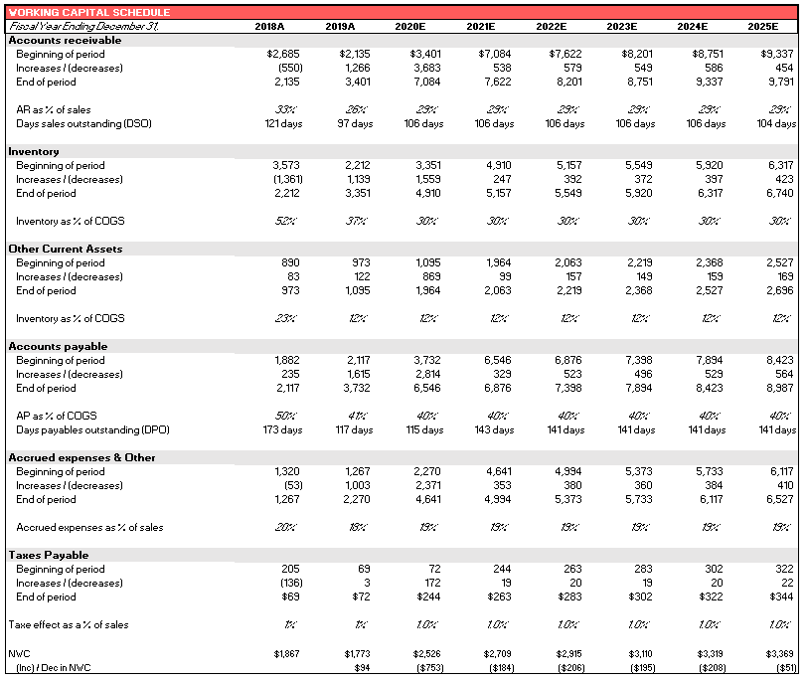
Appendix

Slide 21
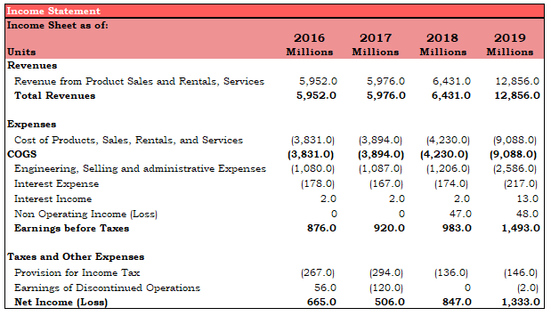
Appendix

Slide 22
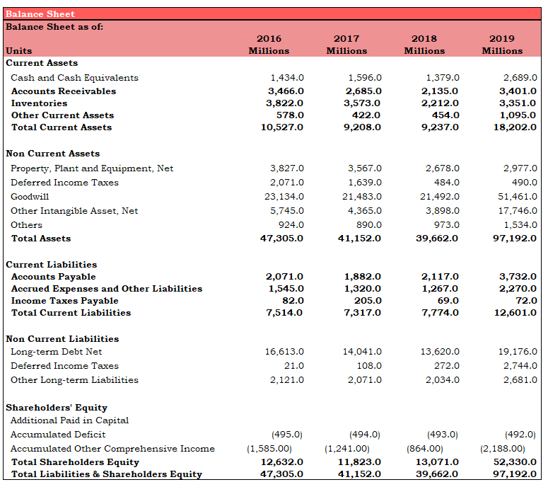
Appendix

Slide 23
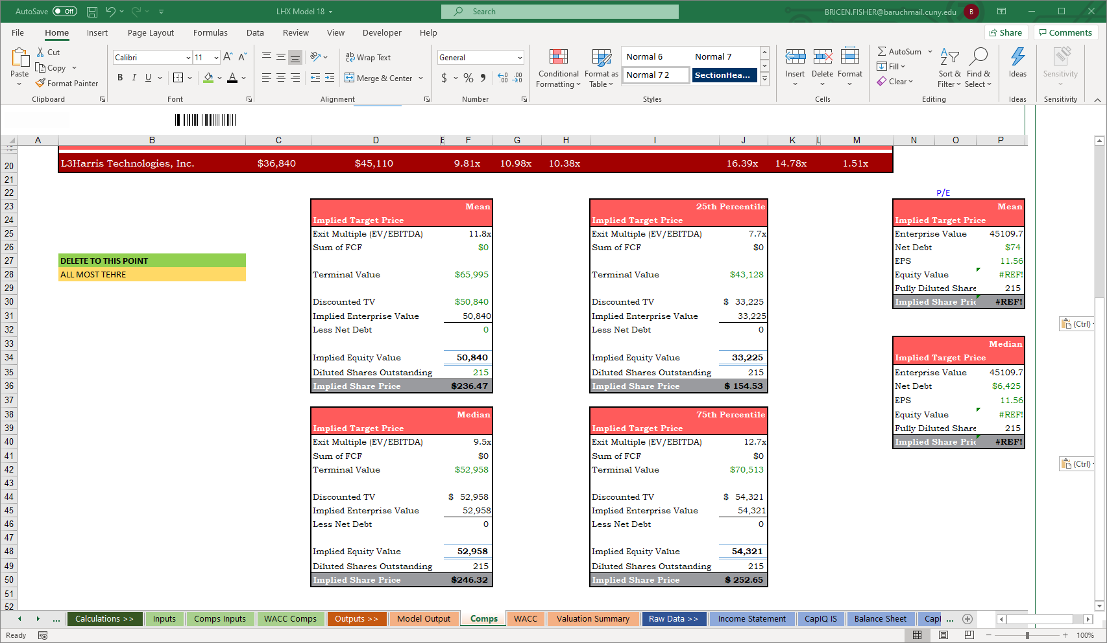
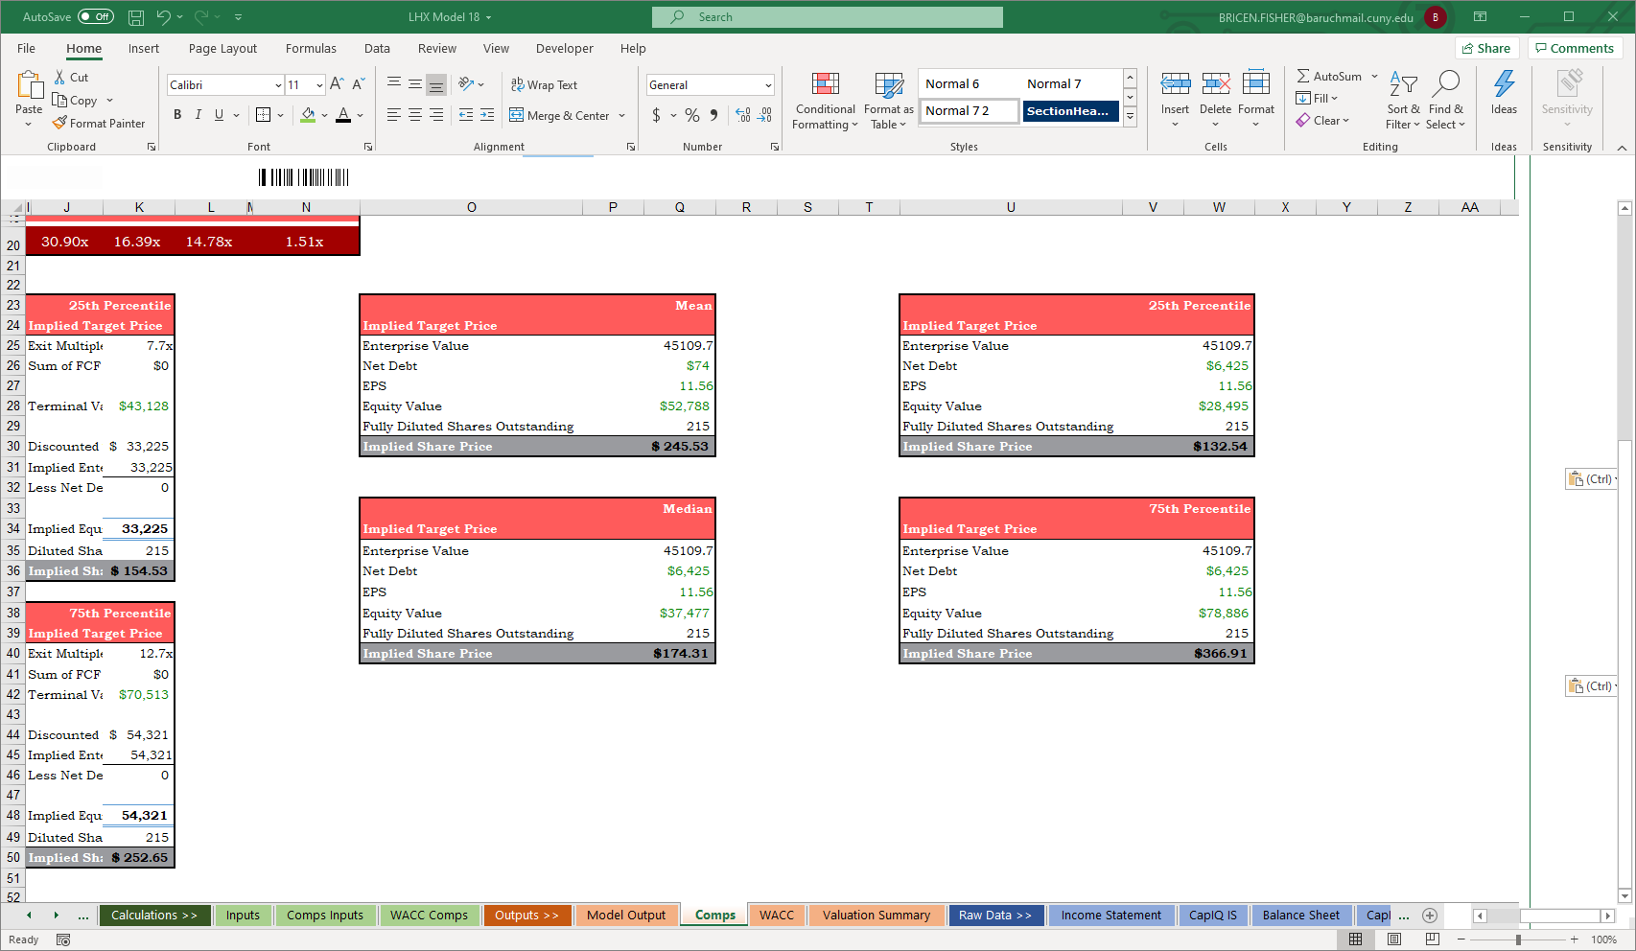
Appendix
EV/EBITDA Valuation
P/E Valuation

